Slide 1
Lecture 7 – K-Nearest Neighbors
Instructor: Hamed Hasheminia

Slide 2
Agenda
Classification problems
Misclassification error
KNN algorithm for classifications
CV for KNN algorithm
Limitations of KNN algorithm
KNN algorithm for regression

Slide 3
Classification Problems
Here the response Variable Y is Qualitative e.g. e-mail if one of C = (spam,ham), digit is on of C = {0,1,…,9}. Our goals are to:
Build a classifier C(X) that assigns a class label from C to a feature unlabeled observations X.
Assess the uncertainty in each classification
Understand the roles of the different predictors among X=(X₁,X₂,…,X_{p})

Slide 4


Classification: some details
Typically we measure the performance of
Using the misclassification error rate:

Slide 5
What is K-Nearest Neighbors?
K Nearest Neighbors (KNN) is a fairly straightforward algorithm used for classification:
For a given point, calculate the distance to all other points.
Given those distances, pick the k closest points.
Calculate the probability of each class label five those points
The original point is classified as the class label with the largest probability (“votes”)

Slide 6
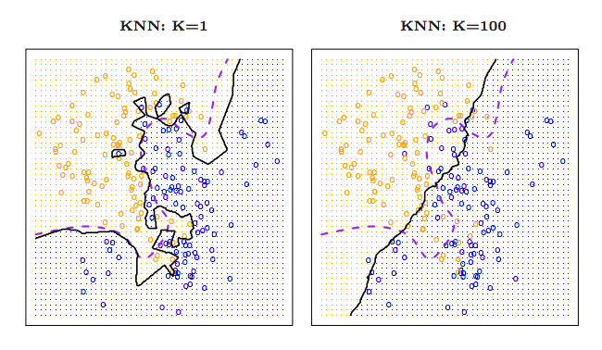

Slide 7
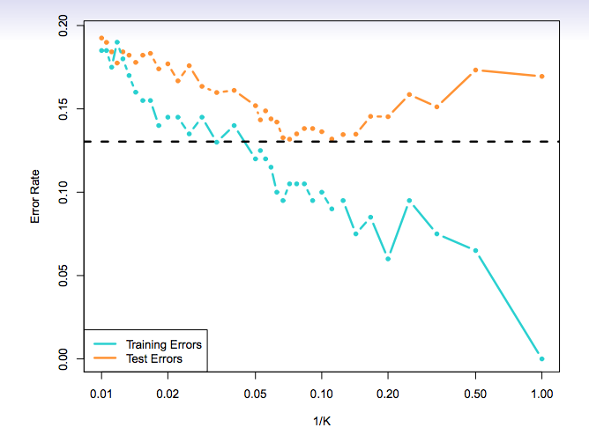
How to choose optimal K

Slide 8
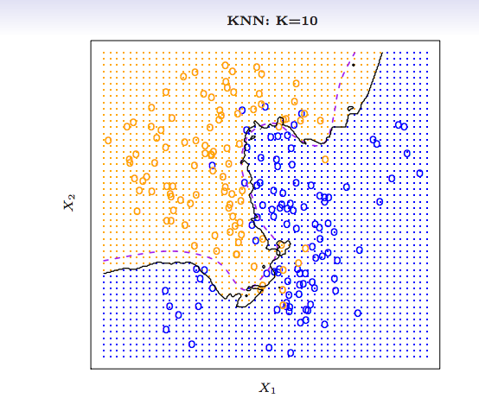

Slide 9
What happen in ties?
In Sklearn, in the case of ties, it will designate the class based on what the algorithm saw first in the training set.
We can also implement “weights”, so that the total distance plays a more significant role.

Slide 10
A few issues with the KNN algorithm
Nearest neighbor algorithm can be pretty good for small number of features i.e. p < 5 and large-ish N
They become extremely lousy when p is large.
Reason: Curse of dimensionality. Nearest neighbors tend
to be far away in high dimensions.
KNN algorithms can be affected by units of your dataset. We
Can resolve this by standardizing our data before training our algorithm. One way to standardize values is (x-min)/(max-min)

Slide 11
K-Nearest Neighbor Algorithm for Regression
You can use KNN algorithm for regression as well.
The algorithm works exactly the same way it works for classification – the only difference is it uses the average of the output of the k-closest observation to your point as your prediction.
How do we decide on the correct size of k?
- Cross-Validation or Validation

Slide 12
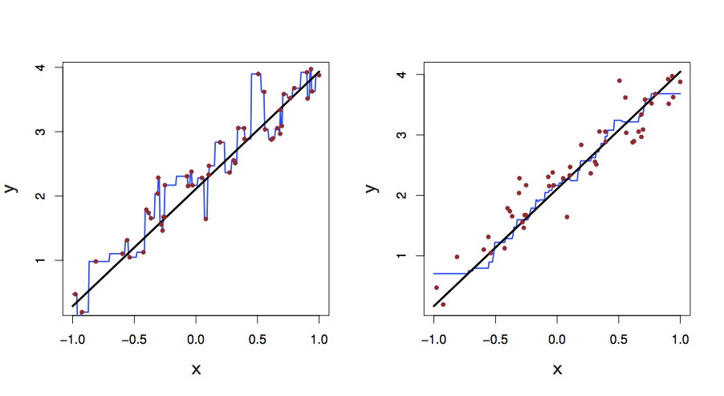
KNN Fits in One Dimension (k =1 and k = 9)

Slide 13
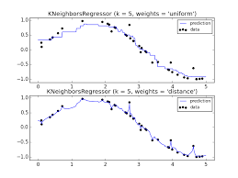

Slide 14
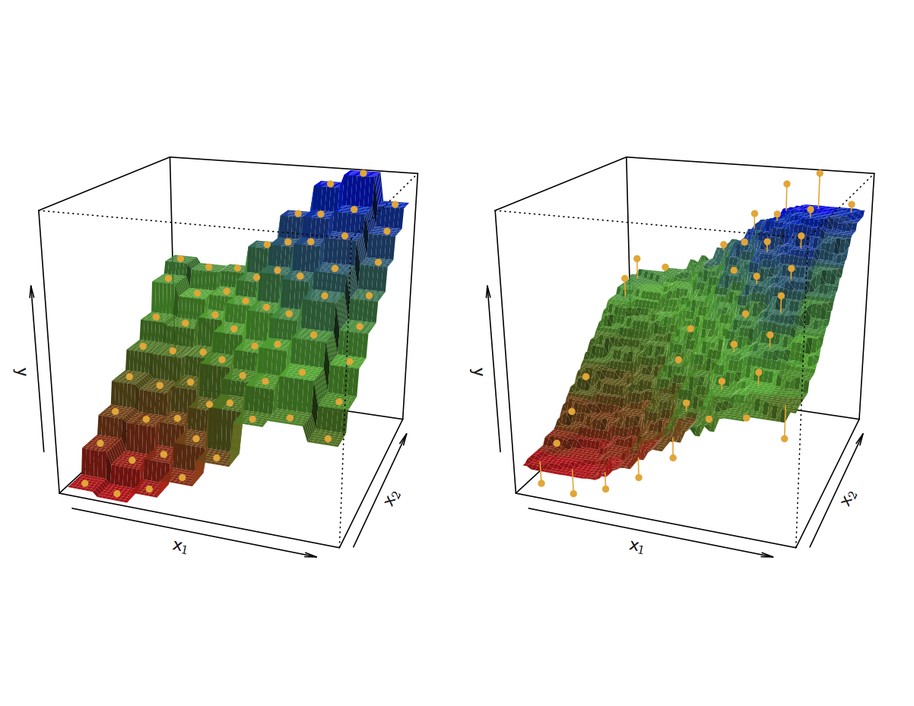
KNN Fits for k =1 and k = 9

Slide 15
Summary
Classification problems
Misclassification error
KNN algorithm for Classification
CV to choose the best k
Limitations of KNN
KNN algorithm for regression

